Slide 1
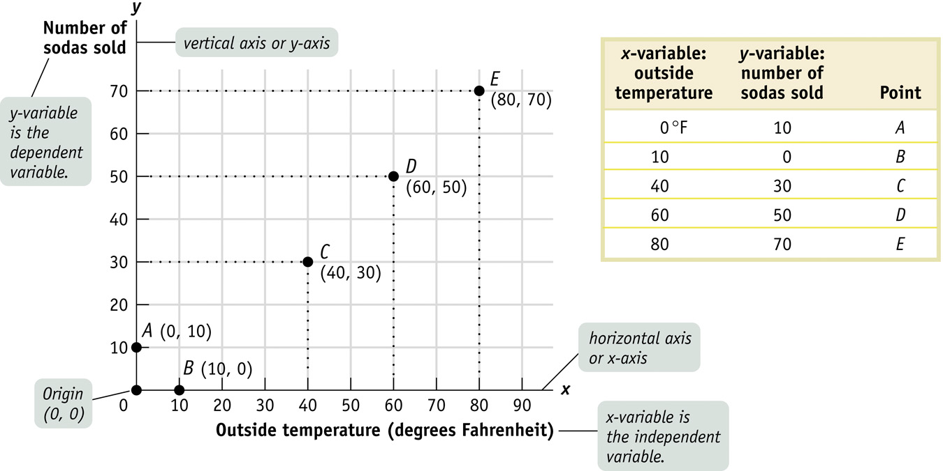
Using Graph - Two Variables
Notes:
We borrowed many Mathematical concepts to help us understanding the Economics concept. Among them is the concept of variables and slope.
In this case: y-variable is a function of x-variable. Or y = f {x}. Y-variable is called the dependent variable, because its changes depend on the changes on x-variable (or the independent variable or explanatory variable).
Example: Number of sodas sold is determined by (or a function of) temperature outside. The warmer the temperature, the more sodas sold (as people are looking for cold drinks). When we collected data on the relationship between the temperature and sodas, we will see that there is a “positive correlation”, as they tend to move together (in the same direction) or the curve is “upward sloping”.

Slide 2
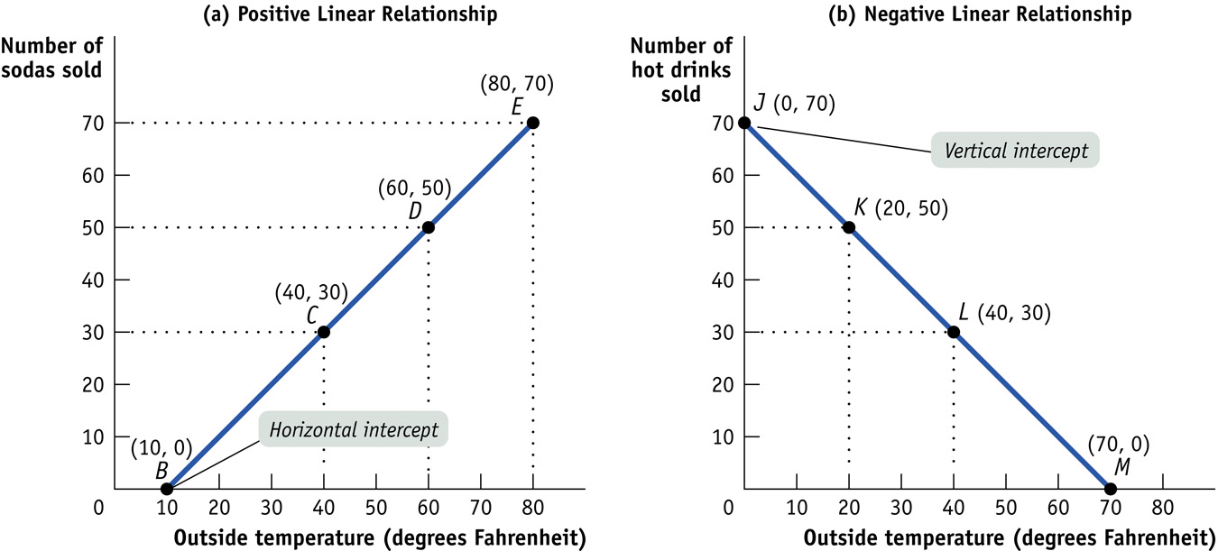
Notes:
Panel a) shows a “positive correlation”, as they (y and x variables) tend to “move” together (in the same direction) or the curve is “upward sloping”.
Panel b) shows a “negative correlation”, as x and y move in the opposite direction: when outside temperature is higher, less people buy hot drinks; and when the temperature is cooler (lower), more people buy hot drinks. The line is called downward sloping.

Slide 3
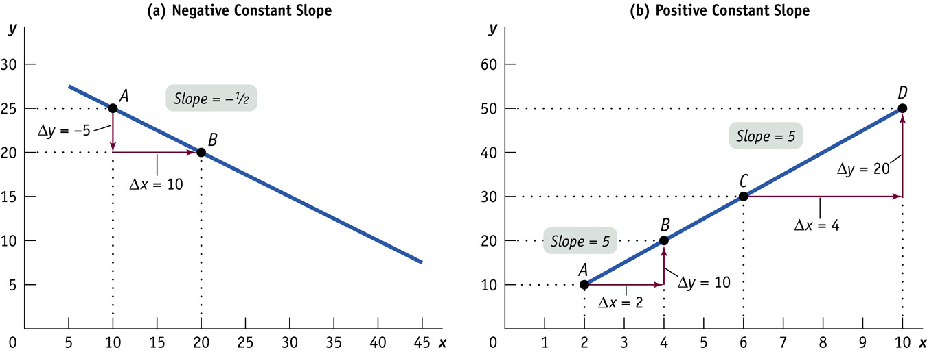
Notes:
The coordinates (x,y) and the slope.
Panel (a): Point A coordinates (10,25), and point B coordinates (20,20). The slope = (y2-y1)/(x2-x1) = (25-20)/(10-20)= - ½
Panel (b): as shown above.
The slope shows 2 things: (1) sign (positive or negative); and (2) size (or magnitude): the larger the number (regardless the sign) means the curve is steeper; the smaller the number, the curve is flatter.

Slide 4
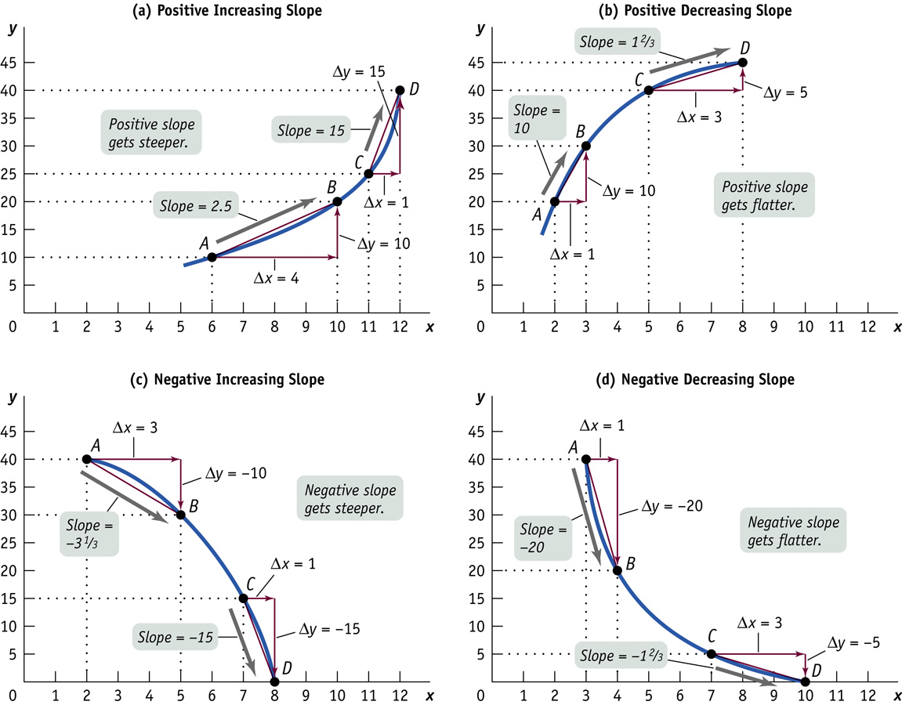
Notes:
For a “Linear” curve, we just need two points (A and B) as in the previous slide, to determine the slope of the curve, because a linear curve has the same slope at any points on that curve.
But for “Non-Linear”, the slope is not constant (changing) as we move along the curve, depending on the shape of the curve.
Panel (a) shows a curve that is positive slope (upward sloping) but as we move to the right on the x-axis, the slope is increasing (it becomes “steeper), hence we call it “positive increasing slope”
Try to understand panel b), c) and d) accordingly.

Slide 5
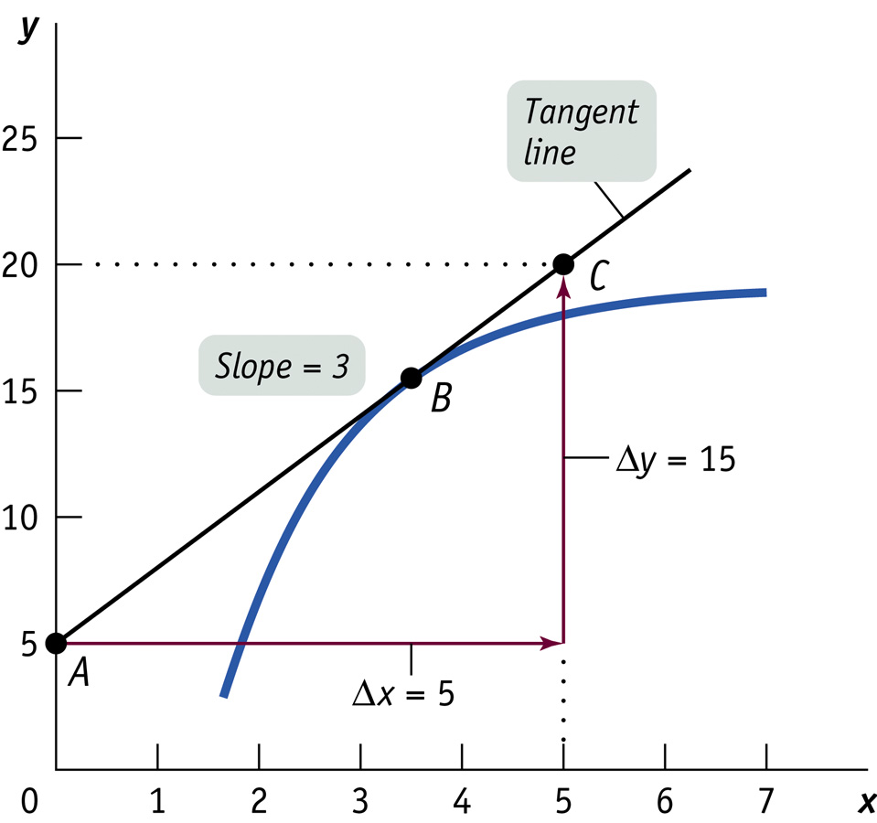
Notes:
A tangent line is a line that just “touch” the curve. If we want to know the slope at a certain point B on a non-linear curve, we draw this tangent line, and we can find the slope, as you can see above.
In Calculus, when we want to find the maximum or minimum point of a curve, or the tangent point can be found by taking the first derivative of the curve, and equate it to zero. For example that curve’s equation is: y = x2 -7x + 100; the first derivative, dy/dx = 2x – 7 = 0; find x = 3.5

Slide 6
The Power of Log
Log₁₀ 1 = 0
Log₁₀ 10 = 1
Log₁₀ 100 = 2
Log₁₀ 1000 = 3
Log₃ 27 = 3
Log₅ 125 = 3
Log₄ 16 = 2
Properties of Log:
Log A.B = Log A + Log B
Log A/B = Log A - Log B
Log A^{B} = B. Log A
Examples: take log of the following:
75 X⁴ Y³
A⁴ / B³
4 K^{0.7} L^{0.3}
Notes:
Example:
Price of a house = f { size of the house, size of the lot, number of bedrooms, number of bathrooms, distance from schools, etc. }
If you took samples of 1,000 homes in your city, and list all the prices along (y-variable) with the relevant (x-variables), and with the help of some statistical tool, you can find a correlation (positive or negative?). This is useful for prediction or estimate of home prices.
You can do the same with, let’s say, stock price.
“Ceteris Paribus”, the Latin word for “other things equal” or “hold others fixed, or constant” is an important assumption when we want to “isolate” the effect of just one x-variable to the change in y-variable. Example, if we know the “slope” between the home price (y) and the number of bathrooms (x) is approximately 500. This means, an additional bathroom will add $500 value to the home price, cet.par. (i.e. holding other variables such as distance to school, the size of the lot, as equal or unchanged). What’s (other) use of this “cet.par”? Think of a reason, or two.

Slide 7
Log normal = Percent change
Log_{e} = Ln
(e = 2.7182718….) comes from:
X (1+ 1/x)^{x}
1 2
10 2.593
100 2.704
1,000 2.7169
…
1,000,000 2.7182718…
Why “ln x” = “% of x”
Y = ln x
dy/dx = 1/x
dy = dx/x = Δx/x = (x2-x1)/x = percent change!
Economic Growth model: Y = f { K, L, H, T }
Notes:
Example:
Price of a house = f { size of the house, size of the lot, number of bedrooms, number of bathrooms, distance from schools, etc. }
If you took samples of 1,000 homes in your city, and list all the prices along (y-variable) with the relevant (x-variables), and with the help of some statistical tool, you can find a correlation (positive or negative?). This is useful for prediction or estimate of home prices.
You can do the same with, let’s say, stock price.
“Ceteris Paribus”, the Latin word for “other things equal” or “hold others fixed, or constant” is an important assumption when we want to “isolate” the effect of just one x-variable to the change in y-variable. Example, if we know the “slope” between the home price (y) and the number of bathrooms (x) is approximately 500. This means, an additional bathroom will add $500 value to the home price, cet.par. (i.e. holding other variables such as distance to school, the size of the lot, as equal or unchanged). What’s (other) use of this “cet.par”? Think of a reason, or two.

Slide 8
Example Using Slope
1) Consumption and Income data as follows:
GDP ($bn) (Y) Consumption Spending (C )
2009 $10,722 $9,846
2012 $12,931 $11,120
Find the equation to represent the consumption function: C = a + b. Y
Predict an estimate for 2014 Spending when the GDP reached $14,000 billion (or $14 trillion).
Consider the coffee production in Brazil:
quantity produced (‘000 tons) Price per ton ($)
2009 2,440 $9,846
2012 3,037 $7,120
Put the coffee production in graph.
Find the equation to represent the coffee market in Brazil.
Notes:
Answer:
A) Airborne pollutants (y) is a function of economic growth rate (x). B) slope = (6-5)/(3-1.5) = 0.67. This means that for every 1% increase in economic growth, the airborne pollutants will increase by 0.67%. c) do the same as b).
Tax owed (y) is a function of salary (x). The slope will be 0.31 (check this yourself), and this means for every dollar increase in income 31% will be taxed.

Slide 9

Models in Economics
Model: a simplified representation of a real situation that is used to better understand real-life situations.
The danger of Faulty Assumptions:
-include wrong variables
-exclude important variables
Ceteris Paribus: cet. par.
Other things equal assumption: all other relevant factors remain unchanged.
We try to treat economics as close to a laboratory science as possible—with only one variable allowed to change at a time
Setup a model for a “Blockbuster Movie”. Find two variables that have positive correlations and two variables that might have negative correlations to the subject.

Slide 10
Using Models: Positive Versus Normative Economics
Positive economics is the branch of economic analysis that describes the way the economy actually works.
According to Zillow.com, price of houses in Bellevue is relatively stable.
Stock market loses 30% of its last year’s value.
Normative economics makes prescriptions about the way the economy should work.
Price of houses in Bellevue is too high.
All children under 15 should get flu vaccine.
Positive economics is about description; normative economics is about prescription.
Using Models, Economists can determine correct answers for positive questions and make forecasts, but typically not for normative questions, which involve value judgments.

Slide 11
Positive statement or Normative?
Stomp your feet for positive statement and meow like a cat for normative statement.
1. The moon is made of green cheese.
2. Rich people should be taxed more.
3. More taxes on the rich will increase tax revenues.
4. Everyone should donate to charity.
5. Everyone needs to work at a bank to see the true value of money.
6. Government intervention in markets is bad.
7. Economics majors earn more on average than sociology majors.
8. Everyone should take Economics course.

Slide 12
Exercise
1. Positive or Normative economics statement?
Inflation is expected to rise following the increase in money supply.
Foreign imports are bad for the economy.
The price of houses in Seattle is too high.
Rent control law should be implemented to help renters.
More than 60% of women are in the labor market.
2. Determine the variables of the following situations, sketch a graph to show which is on the x-axis (the independent variable) or on the y-axis (the dependent variable), and show a curve or a line that shows the relationship (positive or negative or anything else):
1. More experienced workers typically have higher incomes than less experienced ones.
2. Whatever the temperature outside, Americans consume the same number of hot dogs per day.
3. Research finds no relationship between the number of diet books purchased with the number of pounds lost by the average dieter.
4. If the price of movies increases, fewer consumers go to see movies.
(note: on the graph, “Price” is always put on the y-axis, a common agreement in economics study)
Notes:
Answer:
Positive statement: 1, 5,7,8.
Note on 10): this is an example of “Fallacy in composition” : first, the direction of causal relationship (which variable causes what); and secondly, a correlation does not always imply causation; lastly, try to change the word “because” with the words “as a result,”.

